Slide 1
CFD CWM
Luca di Mare
St John’s College
Oxford Thermofluids Institute
Engineering Science Department
University of Oxford

Slide 2
Introduction
This document contains information about the CWM
Logistics/housekeeping
Schedule for the week
Learning objectives
Briefs for the final assessment
We will use a commercial software to study the flow past an aerofoil and then we will modify the aerofoil by adding a flap
Detailed information and step by-step-guides are contained in the documents “Getting started step-by-step” and “CFD CWM Journal File”
Detailed theoretical background is on the file “CWM handout”

Slide 3
Contents
Welcome & housekeeping
Schedule for the week
Mode of assessment
Objectives of the CFD CWM
Practical briefs and design brief

Slide 4
Welcome and housekeeping
Thanks for signing up to the CFD CWM
Generally speaking (except last day)
Morning (9:00-12:00): short lecture/demonstration
Afternoon (13:00-17:00): independent work/practice

Slide 5
Schedule for the week
Monday
Morning: introduction to CFD methods, inviscid flows & practical aspects
Afternoon: test drive
Tuesday
Morning: viscous setups
Afternoon: numerical experiments
Wednesday
Morning: preparation for Friday assessment
Afternoon: more experiments, parametric studies
Thursday
All day: independent work
Friday
Presentations & feedback

Slide 6
Mode of assessment
Assessment is by individual presentation
Presentations will take place on Friday starting 2PM
15 min. per student + 5 minutes questions
Brief at the end of this presentation

Slide 7
Objectives
Fundamentals about discretization schemes
What do the options the solver gives us actually mean?
Running CFD solutions professionally
Well documented and reproducible results
Run efficiently
Present useful information
Awareness that nonsense is always around the corner – and how to avoid it!
How to apply numerical techniques to design problems

Slide 8
Learning Objectives
Create a mesh for a simple geometry
Import the mesh in a commercial CFD solver and setup a run
Perform calculation
Extract results
Study systematically grid independence and robustness of the model

Slide 9
What is CFD
CFD is a collection of techniques
Use computers
Produce approximate solutions to flow problems
It generally proceeds in the following steps
Discretize the flow domain (meshing)
Solve an approximate version of the Navier-Stokes on the discretised domain
Approximations are both numerical (e.g. approximate differential operators)
And physical (e.g. approximate the behaviour of turbulent flow without resolving turbulent structure)
Interrogate the solution for quantities of interest/ assess accuracy

Slide 10
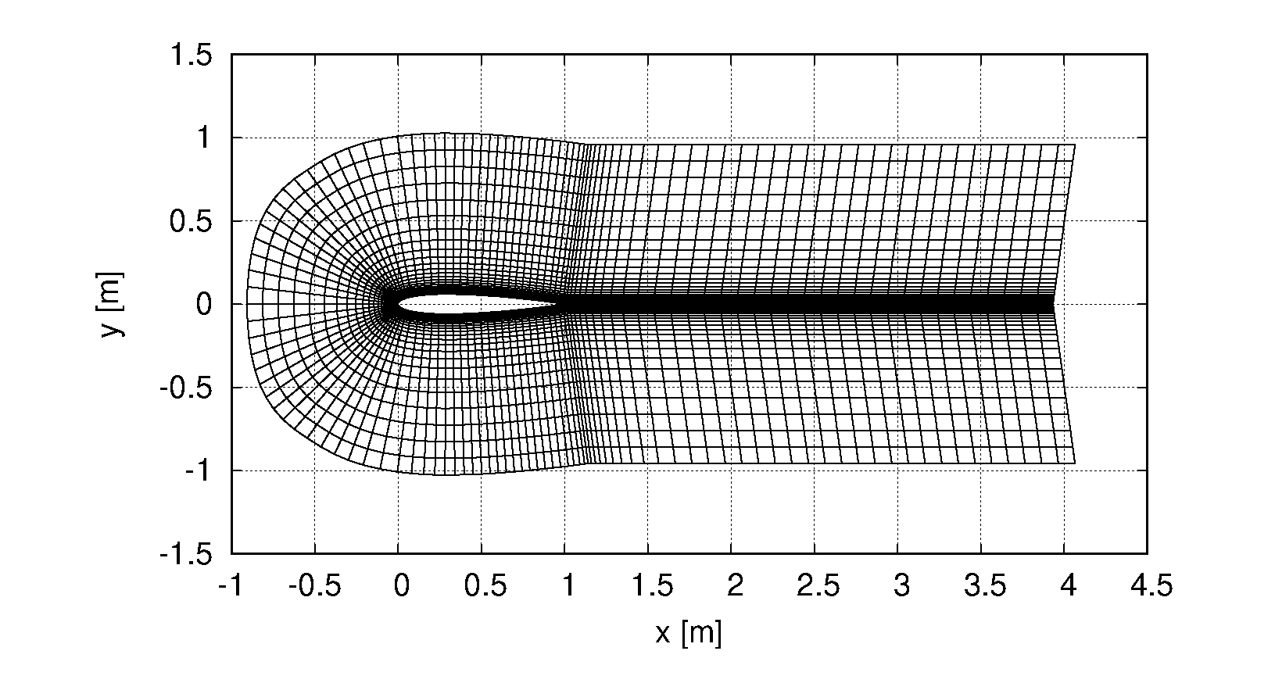
Discretising the flow domain
Most CFD techniques are based on local solutions of the flow equations
Cannot be applied directly to an arbitrary flow domain
But can be applied to small subdomains of simple shape
E.g. tetrahedra, prisms, pyramids, hexahedra
A set of such small subdomains tessellating the flow domain is known as the mesh (or grid)
The collection of techniques used to subdivide a given flow domain into a set of small elements with “good” properties is known as mesh (or grid) generation

Slide 11
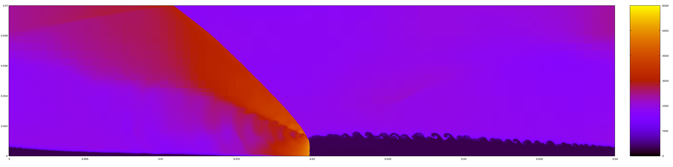
Obtaining a solution
Once a flow domain is discretised a numerical solution can be obtained
What is required is a computer program, the “solver”
The solver has as input
Information about the mesh (position of the nodes, how they are connected by the cells of the mesh, where are the boundaries)
Information about the flow (fluid properties, boundary conditions, models, control parameters)
The output is the numerical solution
A set of flow variables for each node (or cell)

Slide 12
Interrogating a solution
Numerical solutions contain a fair amount of information
Extra information can be obtained by evaluating derived quantities
E.g. wall shear stress or heat fluxes
Typcally, one can look at
Integrals of fluxes on selected boundaries
Mass flux
Integrals of shear stress and normal stress at walls
1D profiles
Coefficients of pressure along lifting surfaces
2D contours (or similar)
Surface/space distributions of flow quantities

Slide 13
Brief – Monday practical
Make sure you are familiar with
Matlab scripts to generate grid
Process to convert Plot3D files into CGNS files
The Journal file
Make sure you know which file goes where and that you keep separate runs (journal file, mesh and results) in different folders
Tasks for today
Find the panels in the interactive setup to set the CFL number, upwinding and numerical fluxes
For an inviscid setup, study the effect of on the lift/incidence characteristic
Grid resolution
Domain size
Study what happens at high incidence (30º). Is it what what you expect in an inviscid flow? Discuss why this is happening

Slide 14
Brief – Tuesday practical
Familiarise yourself with the controls for viscous setups
Invoke the matlab scripts with the correct arguments to generate grids stretched towards the aerofoil wall
Tasks for today
For a viscous setup with a turbulence model of your choice, study the effect of on the lift/incidence characteristic
Grid resolution with particular attention to the wall resolution
Domain size

Slide 15
Brief – Wednesday practical
Familiarise yourself with the script to generate an aerofoil with flap
Setup a systematic study of the effect of flap geometric parameters on performance
Collect lift-drag data

Slide 16
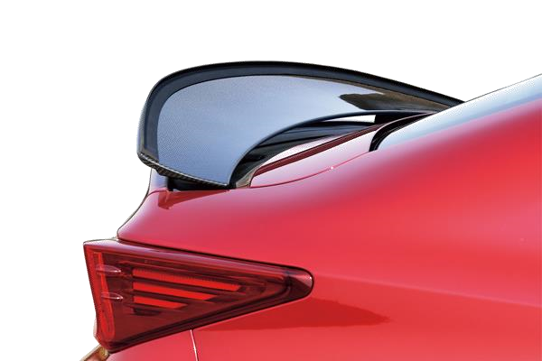
Finally your design brief!
This is a Gurney flap
Small triangular appendix near trailing edge
You see it sometimes on car spoilers
Operates by modifying the effective camber of an aerofoil
Increase lift (in most cases for down-force)
But also drag
ℓ
ℎ

Slide 17
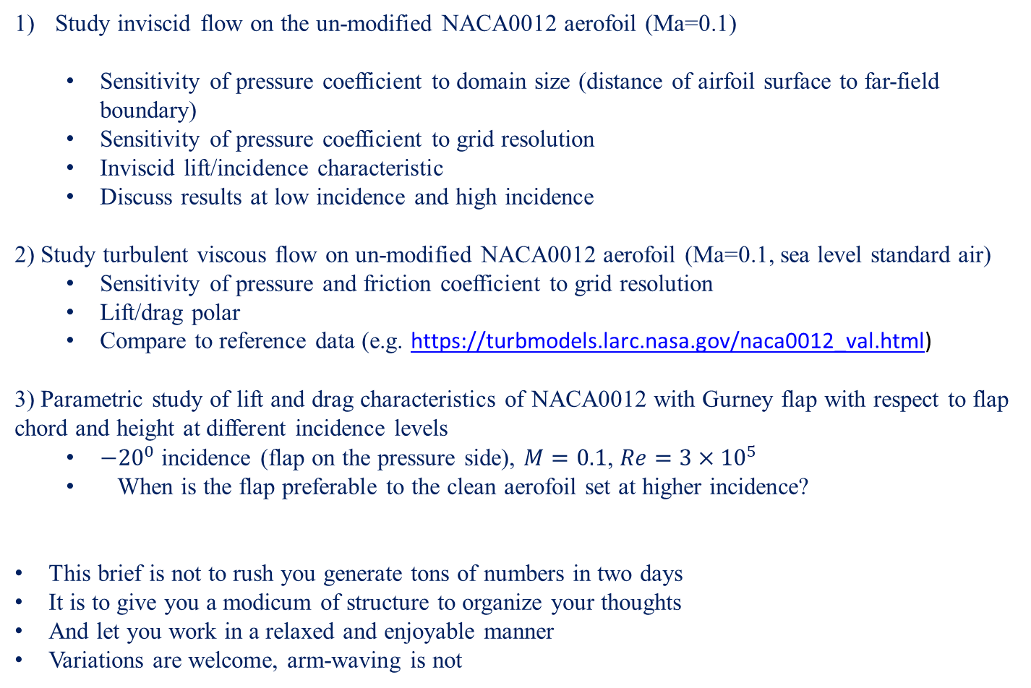
Presentation brief
Study inviscid flow on the un-modified NACA0012 aerofoil (Ma=0.1)
Sensitivity of pressure coefficient to domain size (distance of airfoil surface to far-field boundary)
Sensitivity of pressure coefficient to grid resolution
Inviscid lift/incidence characteristic
Discuss results at low incidence and high incidence
2) Study turbulent viscous flow on un-modified NACA0012 aerofoil (Ma=0.1, sea level standard air)
Sensitivity of pressure and friction coefficient to grid resolution
Lift/drag polar
Compare to reference data (e.g. https://turbmodels.larc.nasa.gov/naca0012_val.html)
3) Parametric study of lift and drag characteristics of NACA0012 with Gurney flap with respect to flap chord and height at different incidence levels
${−20}^{0}$ incidence (flap on the pressure side), $M=0.1$, $Re=3×{10}^{5}$
When is the flap preferable to the clean aerofoil set at higher incidence?
This brief is not to rush you generate tons of numbers in two days
It is to give you a modicum of structure to organize your thoughts
And let you work in a relaxed and enjoyable manner
Variations are welcome, arm-waving is not

Slide 18


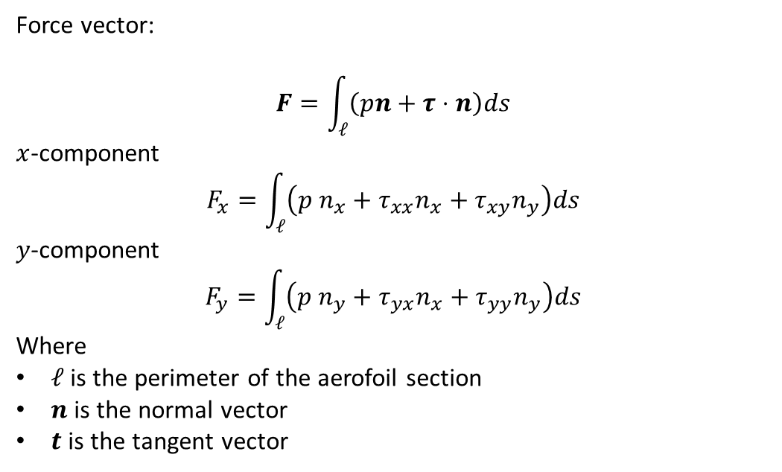
Forces on a solid body immersed in a fluid
$$n$$
$$t$$
Force vector:
$$F=\int_{ℓ}{\left(pn+τ⋅n\right)ds}$$
$x$-component
$$F_{x}=\int_{ℓ}{\left(p n_{x}+τ_{xx}n_{x}+τ_{xy}n_{y}\right)ds}$$
$y$-component
$$F_{y}=\int_{ℓ}{\left(p n_{y}+τ_{yx}n_{x}+τ_{yy}n_{y}\right)ds}$$
Where
$ℓ$ is the perimeter of the aerofoil section
$n$ is the normal vector
$t$ is the tangent vector

Slide 19


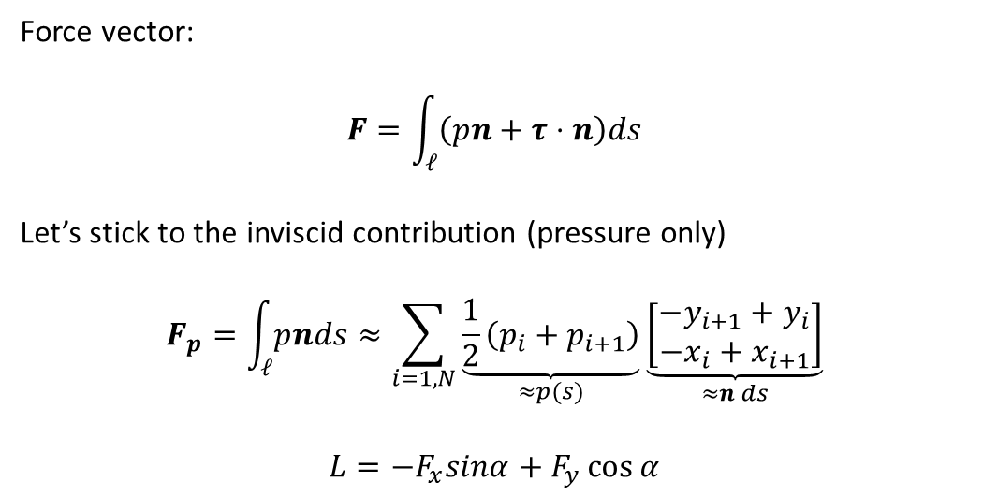



Forces on a solid body immersed in a fluid
$$n$$
$$t$$
$$i$$
$$i+1$$
$$α$$
Force vector:
$$F=\int_{ℓ}{\left(pn+τ⋅n\right)ds}$$
Let’s stick to the inviscid contribution (pressure only)
$$F_{p}=\int_{ℓ}{pnds}≈\sum_{i=1,N}{\underset{≈p(s)}{\underbrace{\frac{1}{2}\left(p_{i}+p_{i+1}\right)}}\underset{≈n ds}{\underbrace{\left[\begin{aligned}−y_{i+1}+y_{i} \\ −x_{i}+x_{i+1}\end{aligned}\right]}}}$$
$$L=−F_{x}sinα+F_{y}\cos{α}$$

